Slide 1

A Project On PASSWORD BASED HOME SECURITY SYSTEM
Submitted by:
Sagar Upadhyaya
Ashim Sapkota
Shubham Ghimire

Slide 2
Contents
Introduction
Objective
Literature Review
Features
Components
Block Diagram
Circuit Diagram
Flowchart
Keypad Working Principle
Applications
Gantt chart
Conclusion
Future Enhancement
References

Slide 3
Introduction
Password Based Home Security System using 8051 Microcontroller is a simple project where a secure password will act as a door unlocking system.
Here once the correct code or password is entered, the door is opened, and the concerned person is allowed access to the secured area.
If the password is wrong, then door would remain closed, denying access to the person.

Slide 4
Objectives
To provide genuine security
To digitalize the locking system

Slide 5
Literature Review
During our research we found some door locking project that has already been developed which varies in their working mechanism.
Some were password based, some of them worked on finger print sensor, some worked on Movement Sensor, message verification and so on.
After overall research we choose to develop password based door locking system that suits our academic project using 8051 microcontroller.
Project References: Door Locking System

Slide 6
Features
Secure password will act as a door unlocking system
LCD display shows if the access is granted or not
Multiple user support
Buzzer makes alarming sound if wrong code entered

Slide 7
Required Components
8051 Microcontroller
8051 Development Board
8051 Programmer
4×4 Matrix Keypad
16×2 LCD
Electric Lock
10KΩ Potentiometer
Connecting wires
Power Supply

Slide 8
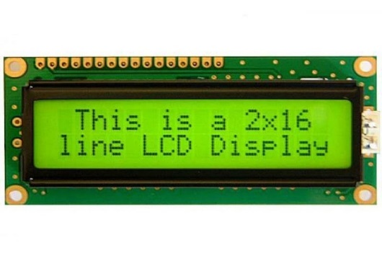
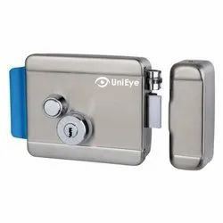
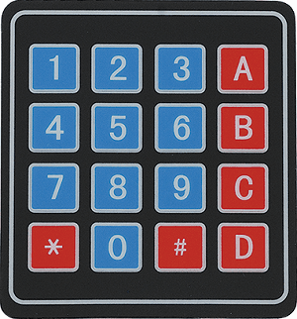
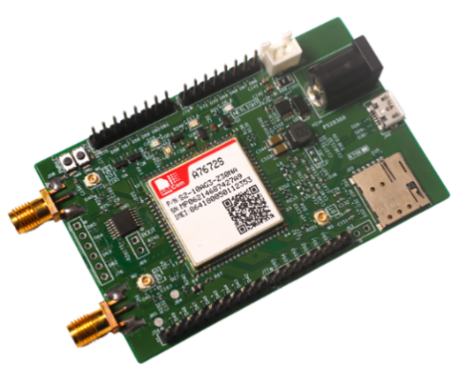

Block Diagram
2*16 LCD DISPLAY
4*4 KEYPAD
Electric Lock
8051 MICROCONTROLLER
GSM MODULE
BUZZER

Slide 9
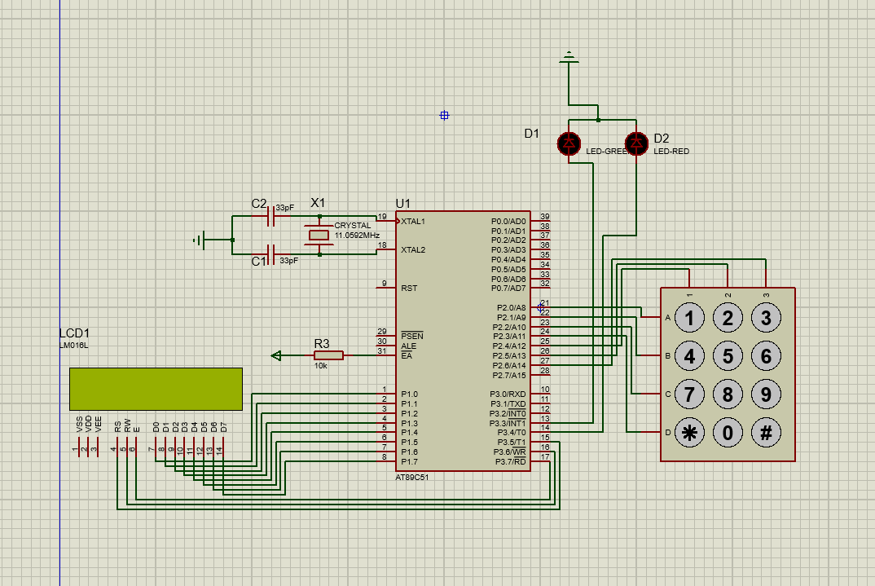
Circuit Diagram

Slide 10
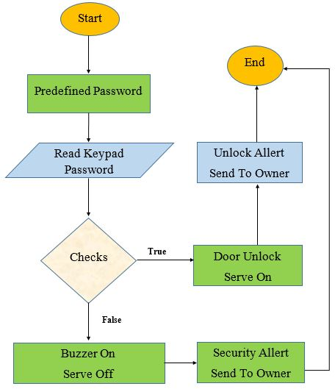
Flowchart

Slide 11
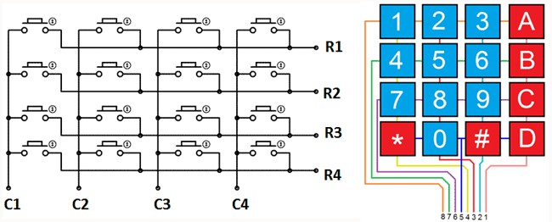
Keypad Working Principle

Slide 12
Applications of Password Based Door Lock System
Password-based door locking systems have a wide range of applications in various fields such as :
Residential
Commercial
Educational
Healthcare
Hospitality
Government
Industrial
Overall, password-based door locking systems are a versatile and secure solution for controlling access to various types of buildings and areas.

Slide 13
Gantt Chart
Task Name | 2022-2023
 | Oct 1 | Nov 1 | Dec 1 | Jan1 | Feb 1 | March 23
System Analysis
System Design
System Implementation
Debugging and Testing
Documentation

Slide 14
Conclusion
Traditional lock systems using mechanical lock and key mechanism are being replaced by new advanced techniques of locking system.
This project is an integration of mechanical and electronic devices whose prominent feature is it’s simplicity and high efficiency.

Slide 15
Future Enhancement
We will make it more effective by adding GSM module, bluetooth

Slide 16
References
Balaguruswamy, E(2011). Programming in C. New Delhi, Tata McGraw Hill Education Private Limited.
Shaba Firdosh, Shikha, Prisha Kashyap, Bhavana Durgam, Nikhar Begum, Shailendra Kumar Singh. (2017, May). home security system. International Journal of Scientific Research in Computer Science and Technology. https://ijsrcseit.com/paper/CSEIT172380.pdf
ElectronicsHub. (2017, August 22). Password based door lock system using 8051 Microcontroller. Electronics Hub. https://www.electronicshub.org/password-based-door-lock-system-using-8051-microcontroller/
Kmhmubin. (2020, October 2). Kmhmubin/password-based-doorlock-system-in-8051-microprocessor. GitHub. https://github.com/kmhmubin/Password-based-doorlock-system-in-8051-microprocessor

Slide 17


